Slide 1

Capstone Project - The Battle of Neighborhoods
Kitchener Vs. Waterloo, ON
Can a New Sushi Restaurant be Successful in Either Kitchener or Waterloo Neighbourhoods?

Slide 2
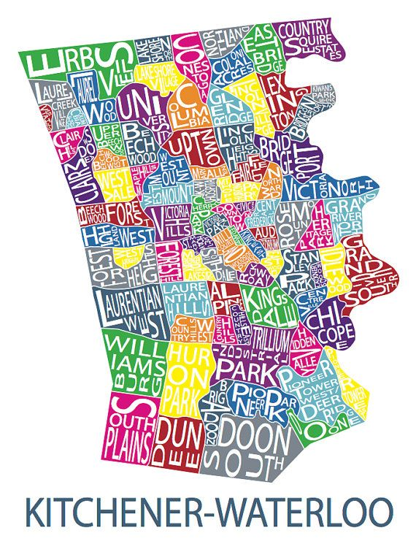
Introduction:
In this project we will try to find an optimal location for stakeholders to open a new sushi restaurant in either Kitchener or Waterloo, ON.
Sushi is a popular choice in the area of Kitchener and Waterloo. This is partly due to the Universities in town and the booming tech scene that supply patrons of these restaurants. Sushi in the area of Kitchener and Waterloo can be a quick, easy meal and it can also be a tidy meal because it offers many delicious bite size varieties.

Slide 3
Business Problem
With so many options of attracting different kinds of patrons with different needs and due to it's popularity in the Kitchener/ Waterloo area it seems natural that stakeholders could be interested in investing in a new sushi restaurant in the area. However, is this type of restaurant already too popular in the area? Is there any space left in these neighbourhoods where a new restaurant could be successful?

Slide 4
Business Problem Cont.
To answer these questions, we will need to find out if these areas are already too saturated to support another sushi restaurant. Since there is assumed to be a lot of sushi restaurants in the Kitchener/Waterloo area we will try to detect locations that are not already crowded with sushi restaurants. We are interested in areas with little or no sushi restaurants in these neighbourhoods. We would also prefer locations as close to the Universities as possible, assuming that the first two conditions are met.

Slide 5
Business Problem Cont.
We will use data analysis to generate a few of the most promising areas of Kitchener/Waterloo neighbourhoods for a new sushi restaurant based on this criteria so that a final location can be chosen by stakeholders or so that we can determine that this type of restaurant is not likely to be successful in these areas and perhaps determine that the stakeholders should continue their search in another nearby area such as Cambridge or Elmira, ON. Or, perhaps the data will show that they should look at choosing a different type of restaurant altogether if they are set on entering the market in these neighbourhoods.

Slide 6
DATA
Based on definition of our problem, factors that will influence our decision are:
number of existing restaurants in the neighborhood (any type of restaurant)
number of and distance to sushi restaurants in the neighborhood, if any
distance of neighborhood from any Universities (or if no Universities available in the area then Colleges)

Slide 7
DATA CONT.
We decided to use regularly spaced grid of locations, centered around city center, to define our neighborhoods.
Following data sources will be needed to extract/generate the required information:
centers of candidate areas will be generated algorithmically and approximate addresses of centers of those areas will be obtained using Google Maps API reverse geocoding
number of restaurants and their type and location in every neighborhood will be obtained using Foursquare API
coordinate of Kitchener/Waterloo center will be obtained using Google Maps API

Slide 8
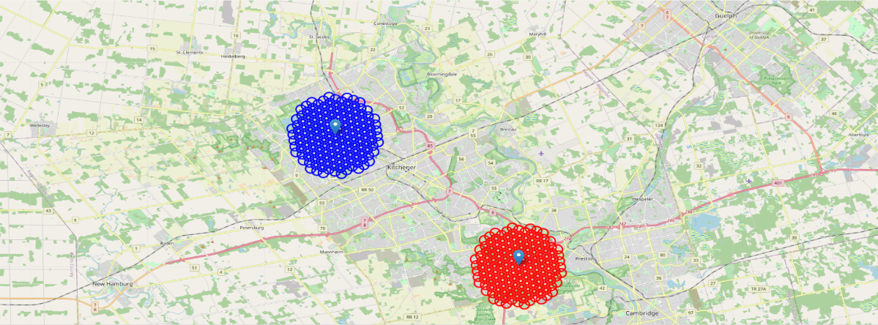
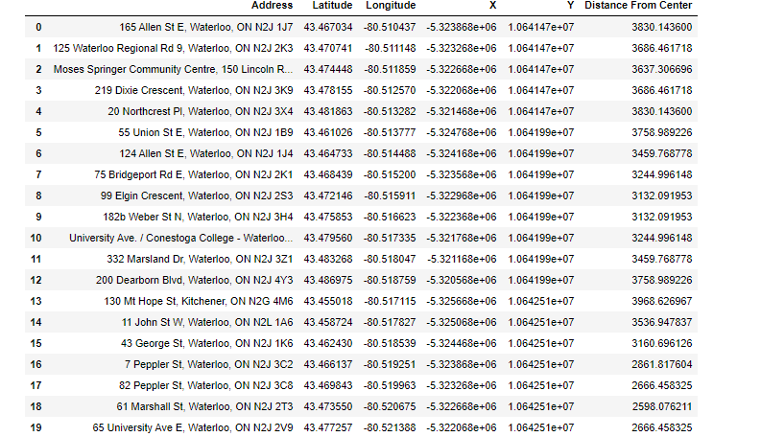
DATA CONT.
MAP of Clustered Neighbourhoods of Kitchener/ Waterloo
Table of Clustered Neighbourhoods of Kitchener/ Waterloo

Slide 9
Foursquare
Now that we have our location candidates, we will use Foursquare API to get info on restaurants in each neighborhood.
We're interested in venues in 'food' category, but only those that are proper restaurants – coffee shops, pizza places, bakeries etc. are not direct competitors so we don't care about those. So, we will include in our list only venues that have 'restaurant' in category name, and we'll make sure to detect and include all the subcategories of specific 'sushi restaurant' category, as we need info on sushi restaurants in the neighborhood.

Slide 10
Methodology
In this project we will direct our efforts on detecting areas of Kitchener/ Waterloo that have low restaurant density, particularly those with low number of sushi restaurants. We limit our analysis to an area ~5km around Universities and Colleges.
In first step we have collected the required data: location and type (category) of every restaurant within 5km from Kitchener/Waterloo Universities and Colleges. We have also identified sushi restaurants.
In the final step we will explore our original question, which is the best neighbourhood to start a new sushi restaurant Kitchener or Waterloo or neither?

Slide 11
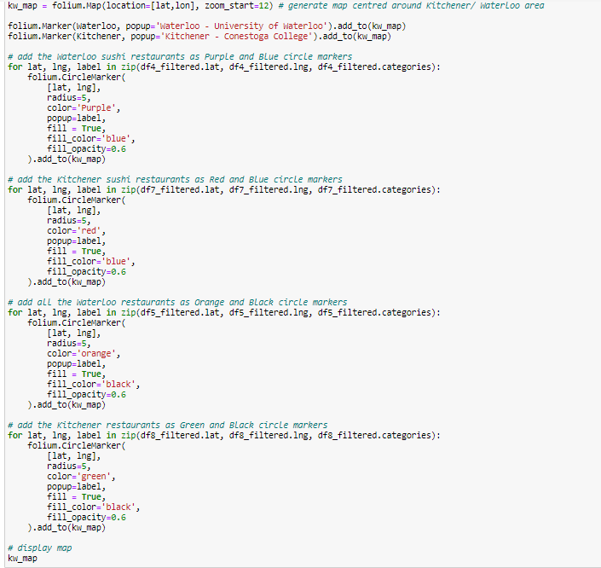
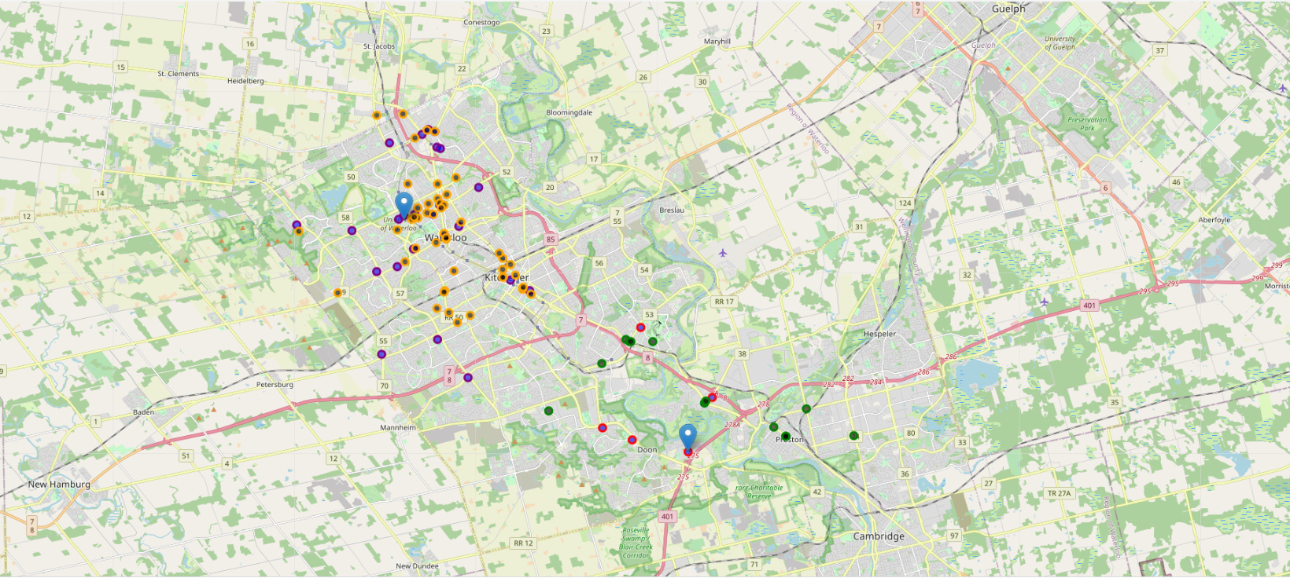
Restaurants in the KW Area
MAP of Restaurants and Sushi Restaurants in the KW Area Near Universities & Colleges
Marker Descriptions

Slide 12
Results and Discussion
Our analysis shows that there is a great number of restaurants in Waterloo, there are few pockets of low restaurant density fairly close to the University areas. The Highest concentration of restaurants was detected near the University and uptown Waterloo. Other areas of Waterloo away from the Universities may be able to support a new type of restaurant but we were focused on the areas near the Universities which offers a high traffic area and a certain popularity among students.

Slide 13
Results and Discussion CONT.
Our analysis also shows that although there is a good number of restaurants in Kitchener, there are pockets of low restaurant density fairly close to Conestoga College's Doon campus. The highest concentration of restaurants was detected near Kitchener's city centres our focus and interest in the area around the area of the college when looking at all restaurants seems to suggest it could support a new restaurant which would still offer a popularity among students, and a high traffic area.

Slide 14
Results and Discussion CONT.
After defining our neighbourhoods of Kitchener and Waterloo and looking at all restaurants in the area we then directed our attention to sushi restaurants in the area covering an approximately 5 KM area from each location.
Location candidates were geocoded to be used as markers and positioned on a map for a more detailed view of the restaurants and sushi restaurants in the area.

Slide 15
Results and Discussion CONT.
Result of all this is a list of 64 restaurants cumulatively in Kitchener/ Waterloo as well as 29 sushi restaurants cumulatively in Kitchener/ Waterloo. This, of course, does not imply that those zones are actually optimal locations for a new restaurant! Purpose of this analysis was to only provide info on areas close to Kitchener/ Waterloo Universities and Colleges but not crowded with existing restaurants (particularly sushi) - it is entirely possible that there is a very good reason for small number of restaurants in any of those areas, reasons which would make them unsuitable for a new restaurant regardless of lack of competition in the area. Recommended zones should therefore be considered only as a starting point for more detailed analysis which could eventually result in location which has not only no nearby competition, but also other factors taken into account and all other relevant conditions met.

Slide 16
Conclusion
Purpose of this project was to identify if the Kitchener or Waterloo area could sustain another sushi restaurant near the College/ University areas. We were looking for a low number of restaurants (particularly sushi restaurants) in order to aid stakeholders in narrowing down the search for optimal location for a new sushi restaurant. By mapping restaurant density distribution from Foursquare data, we have visually shown areas which have a high density of restaurants, a low density of restaurants, a high density of sushi restaurants, and low densities of sushi restaurants.

Slide 17
Conclusion Cont.
Final decision on optimal restaurant location will be made by stakeholders based on specific characteristics of neighborhoods and locations in every recommended zone, taking into consideration additional factors like attractiveness of each location (proximity to park or water), levels of noise / proximity to major roads, real estate availability, prices, social and economic dynamics of every neighborhood etc.

Slide 18
Conclusion Cont.
Our initial analysis of these two areas shows them to be rather full of sushi restaurants in our areas of interest and these stakeholders might have a better time if they expanded their search to include a Cambridge or Elmira location rather than the Kitchener/ Waterloo area's which already seem to have a rather competitive market around the University/ College area.

